Slide 1

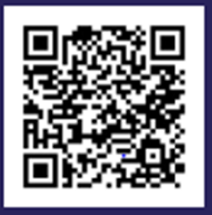
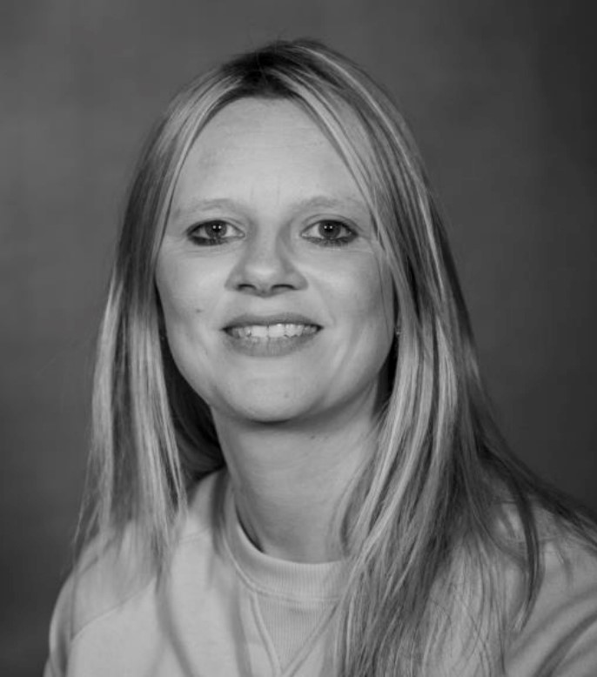

Drop In for Young people,
Parents and Carers
Come along and meet Lex our Community Worker who will be ready to answer your questions/listen to worries about family life and share information about a wide range of activities, groups and organisations that can help.
Friday 8th November ECFS base South Lynn 9:30am – 11:30am
Tues 12th November Gaywood Library 10am -11:30am
Saturday 16th November Kings Lynn Library 10.30am – 12pm
Weds 20th November Beacon Café North Lynn 10:30am – 12pm
Should you wish to book an appointment with Lex for any other convenient time to have a chat please call the Family hub on 01553 669651 to arrange this. You can also talk to one of our advisors who will be happy to help by popping along to St Augustine's Centre anytime Mon-Fri between 9am and 4pm to see them face to face
You can find out more about our family hubs approach online, just scan the QR code

