Slide 1

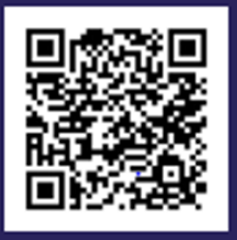
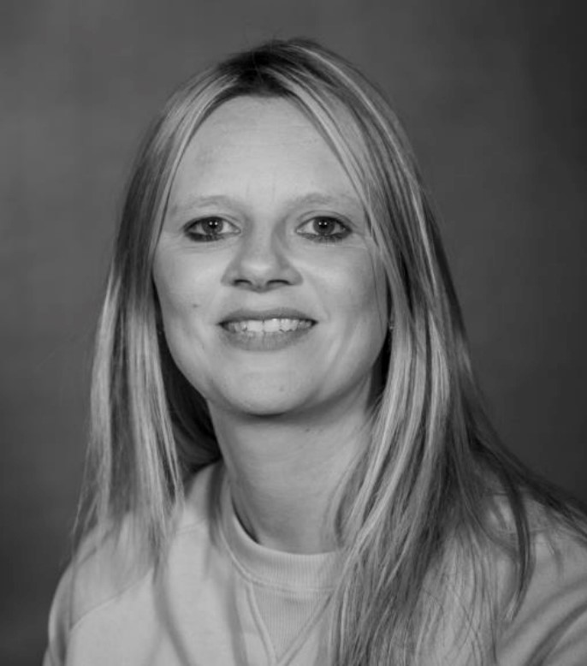

Drop In for Young people,
Parents and Carers
Come along and meet Lex our Community Worker who will be ready to answer your questions/listen to worries about family life and share information about a wide range of activities, groups and organisations that can help.
Saturday 31st May Kings Lynn Library 10:30am -12pm
Friday 13th June Hunstanton Library 10:00am – 12pm
Wednesday 18th June Dersingham Library 10:30am – 12pm
Friday 20th June ECFS South Lynn 9:00am – 11:00am
Saturday 21st June Kings Lynn Library 10:30am -12pm
Should you wish to book an appointment with Lex for any other convenient time to have a chat please call the Family hub on 01553 669651 to arrange this. You can also talk to one of our advisors who will be happy to help by popping along to St Augustine's Centre anytime Mon-Fri between 9am and 4:30pm to see them face to face
You can find out more about our family hubs approach online, just scan the QR code

